Slide 1




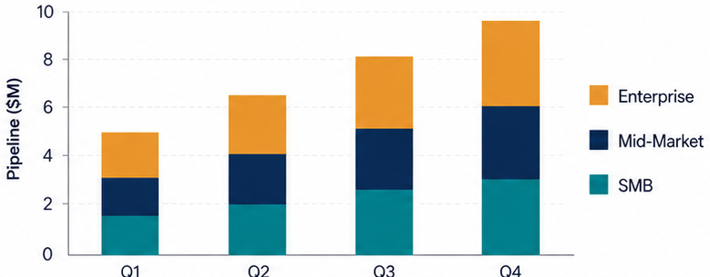
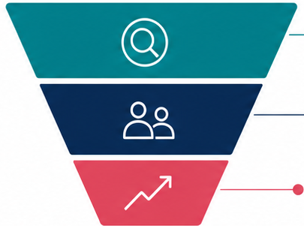



SaaS Revenue Expansion Dashboard
Prioritizing expansion motions across segments, regions, and product adoption signals
Net Revenue Retention
Expansion Pipeline
Product Adoption
Renewal Risk
124%
$8.4M
71%
-18%
Expansion Pipeline by Customer Segment
Expansion Pipeline by Stage
Identify
Top-of-funnel accounts with
expansion potential
Engage
Active expansion conversations
and solution alignment
Expand
Committed expansion
and revenue growth
Q1 Segment Focus
Q2 Pricing Tests
Q3 Partner Motion
Prioritize high-potential segments
and expansion plays
Validate pricing levers
and packaging for expansion
Activate partners to drive
co-sell and expansion

