Slide 1

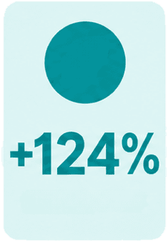
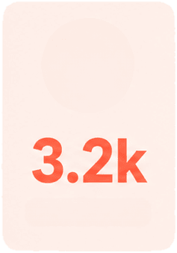
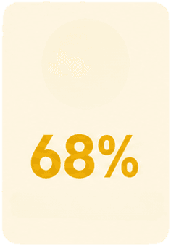




Q3 Product
Launch Highlights
Channel mix
Growth, adoption, and customer signals
42
Launch reach
Trial signups
Feature adoption
Markets
Organic Search
Email
Paid Social
Other
Direct

