Slide 1
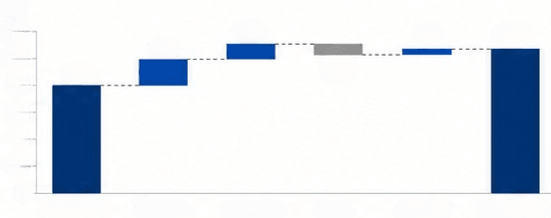



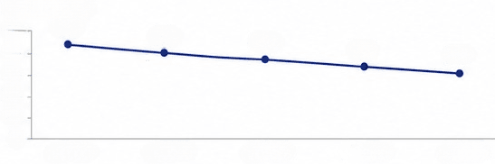




Board Operating Brief
Q2 revenue quality and efficiency review
Revenue Mix
Key Evidence (Q2)
$M
120
18.7
12.1
3.6
107.3
100
80.2
(7.3)
ARR
Renewal
80
60
+18.6%
92.4%
40
Conclusion:
20
0
Q1 Revenue
New logo
Expansion
Churn
Price / FX
Q2 Revenue
growth came from
high-quality accounts
CAC
On-time
Channel Efficiency
-11.8%
97.1%
$K per $1M ARR
50
44.8
41.6
39.3
0 30 20 10
37.2
40
35.3
Strong renewal performance
driving durable revenue
Efficiency gains reduce
acquisition costs
0
Q2 FY23
Q3 FY23
Q4 FY23
Q1 FY24
Q2 FY24
Priority | Owner | Status
Enterprise expansion | VP, Enterprise Sales
Partner review | VP, Partnerships
Self-serve conversion | VP, Growth
Operational reliability
remains a competitive edge
In progress
Complete
Review next
Risk: mid-market collections cycle is lengthening

