Slide 1






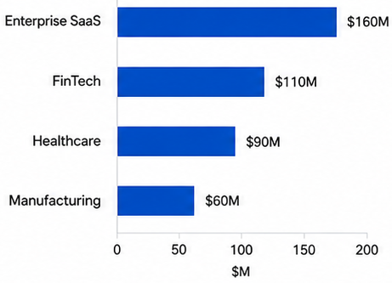








2026 Enterprise Market Expansion Plan
Segment focus • Revenue acceleration • Customer success
1. Priority Segments
2. Execution Roadmap
3. Opportunity Matrix
2026 Revenue Opportunity (by segment)
1
2
3
High
Focus ICP
Scale Channels
Expand Accounts
Market Attractiveness
• Define ideal customer profile
• Prioritize high-potential segments
• Build tailored value propositions
• Expand partner network
• Activate digital + ABM
• Improve channel productivity
• Land & expand strategy
• Cross-sell & upsell
• Increase account penetration
Low
Q1-Q2
Q2-Q3
Q2-Q4
Our Competitive Strength
High
Sharper ICP
Higher Channel ROI
Retention-Led Growth
Focus resources on high-fit segments to increase win rate and deal quality.
Scale partner and digital channels to accelerate pipeline and revenue.
Expand relationships to drive NRR and sustainable growth.

